Slide 1
Gadgets and Grains
Journey through my meal prep tips
and explore the rich world of grains.

Slide 2
Obstacles to cooking at home
Lack of time
Lack of energy
Not knowing what to cook/no plan
Cleaning up afterwards
Hungry before starting to cook
Lacking the skills or confidence to cook without a recipe or adapting one
Not getting the timing right
Shopping for groceries
Obligations/distractions from kids’ activities, etc.

Slide 3
Benefits to home cooking
Healthier—foods that you create in your kitchen will be much healthier than the processed foods from the supermarkets and the higher sodium/higher calorie/higher saturated foods prepared in restaurants and fast- food outlets.
Relaxing—cooking stimulates all your senses. The smell of the food, the sizzling of the cooking process, the touch of a kneading process, or the sight of a colorful plate. These stimuli can relax the body and mind.
Social connection—cooking together stimulates conversation and helps everyone feel connected.
Saves money—we save a lot of money buying the ingredients to prepare a meal and have leftovers for lunch the next day
Time management—with a little bit of ingredients planning, cooking at home actually saves time. By the time we drive to a restaurant, wait in line, wait for the food and eat it, we will have cooked and eaten and cleaned at home.
Sharpening brain activity—cooking at home challenges time management skills with preparing and planning for the different parts of the cooking process. We are constantly using our brains to work out the next stage of the cooking process.
Boosts confidence—perfecting recipes from around the world proves our versatility and adaptability to various skills. Cooking can be a challenge, but creating a masterpiece can really boost confidence.

Slide 4
Solutions to cooking at home more
Buy pre-prepped veggies
Prep vegetables in advance (in the morning or day before)
Use smart kitchen tools (mandolin, food processor, chopper, etc.)
Cook big batches and freeze it for a quick meal
Prepare some basic components like sauces, herbs, shredded chicken and freeze them to use in a pinch
Utilize pressure cookers or Instant Pots
Prepare a slow cooker in the morning and have dinner ready when you get home

Slide 5
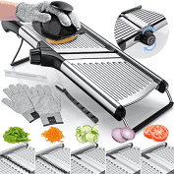
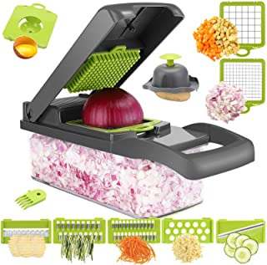
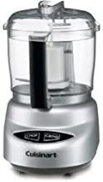
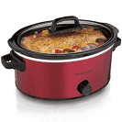
My favorite gadgets/appliances

Slide 6
Protein needs and perspective
Average female needs approx. 48--50 grams protein/day
Average male needs approx. 56-58 grams protein/day
As we get older, we may need closer to 60 grams protein/day if we are deconditioned and trying to rebuild muscle
One piece of chicken breast (4 oz) or 1 cup of chicken is approx. = 35 grams protein
Goal: incorporate plant-based proteins and decrease animal-based proteins

Slide 7
History of grains
The origin of grains goes back to about 10,000 years ago, when prehistoric communities transitioned from hunter-gatherer to farmer.
The Inca people called quinoa the “mother of all grains”.
The Aztecs considered amaranth to be sacred and used it as part of a religious ceremony.
Farro is mentioned in the Old Testament.

Slide 8
Ancient grains vs Whole grains
Ancient grains have never been processed through hybridization or genetic modification (non-GMO) so they are essentially still grown as they were a thousand years ago.
Modern grains include wheat, corn, and rice.
Ancient grains offer more protein, fiber, and vitamins than modern grains and are more nutritionally dense.
Unfortunately, ancient grains do end up costing more.

Slide 9
Whole grains vs Refined grains
Whole grains are more nutritious and overall healthier for us than refined grains.
Whole grains have three parts—the bran, endosperm and the germ. These give us the phytonutrients, vitamins and antioxidants needed to protect against chronic disease.
Refined grains get rid of the bran and germ in the processing, so we lose the fiber and many of the nutrients.
Most whole grains have plenty of fiber, which lowers cholesterol, improves digestion, provides the prebiotics needed to work with the probiotics and stabilizes blood sugar.

Slide 10
Nutritional comparison: Whole Wheat vs White Flour
Main difference between white flour and whole wheat is the fiber content.
The more fiber in our foods, the better regulated the glucose metabolism

Slide 11
Quinoa
Originated from the Andes
Favorite grain of the ancient Incas
More similar in its structure to chard and spinach than to wheat or barley
It is a complete protein
Gluten-free and kosher
Can use in savory dishes or as a breakfast
1 cup = 5.18 grams of fiber and 8.14 grams protein

Slide 12
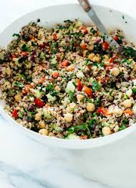
Quinoa

Slide 13
Barley
Nutty and chewy texture that doesn’t get mushy when cooked
Great for soups, stews and cereals
Rich in fiber and manganese
Unhulled barley has more protein than pearled barley
Longer cooking time so works well in slow-cooker
1 cup = 6 grams of fiber and 3.6 grams of protein

Slide 14
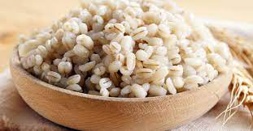
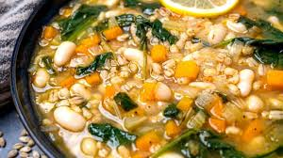
Barley

Slide 15
Buckwheat
Buckwheat is not a wheat at all but a fruit seed
Rich in fiber and vitamins
Native to northern Europe
Used in pancakes, soups and stews
Comes in varied forms, from kasha in Eastern European cuisines to soba noodles in Japan
Naturally gluten-free
1 cup = 4.5 grams fiber and 5.7 grams protein

Slide 16
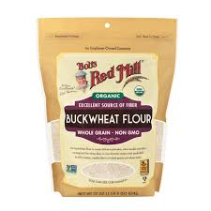
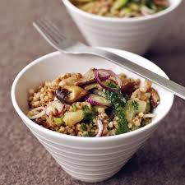
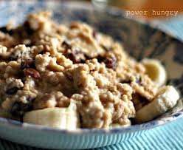
Buckwheat

Slide 17
Amaranth
Very rich in protein (high proportion of amino acids)
Can be used in cereals, breads, muffins, crackers, and pancakes
Naturally gluten free
Can help lower blood pressure
1 cup = 6 grams fiber and 9 grams protein

Slide 18
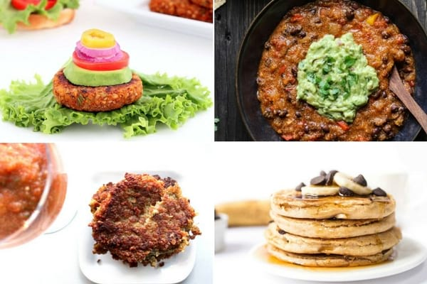
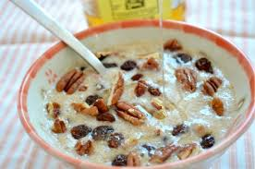
Amaranth

Slide 19
Kamut
This is a wheat grain with a nutty, buttery flavor
Works well in baked goods like breads, cookies, brownies, and muffins
Higher in protein and vitamin E than common wheat
1 cup = 7.4 grams fiber and 9.8 grams of protein

Slide 20
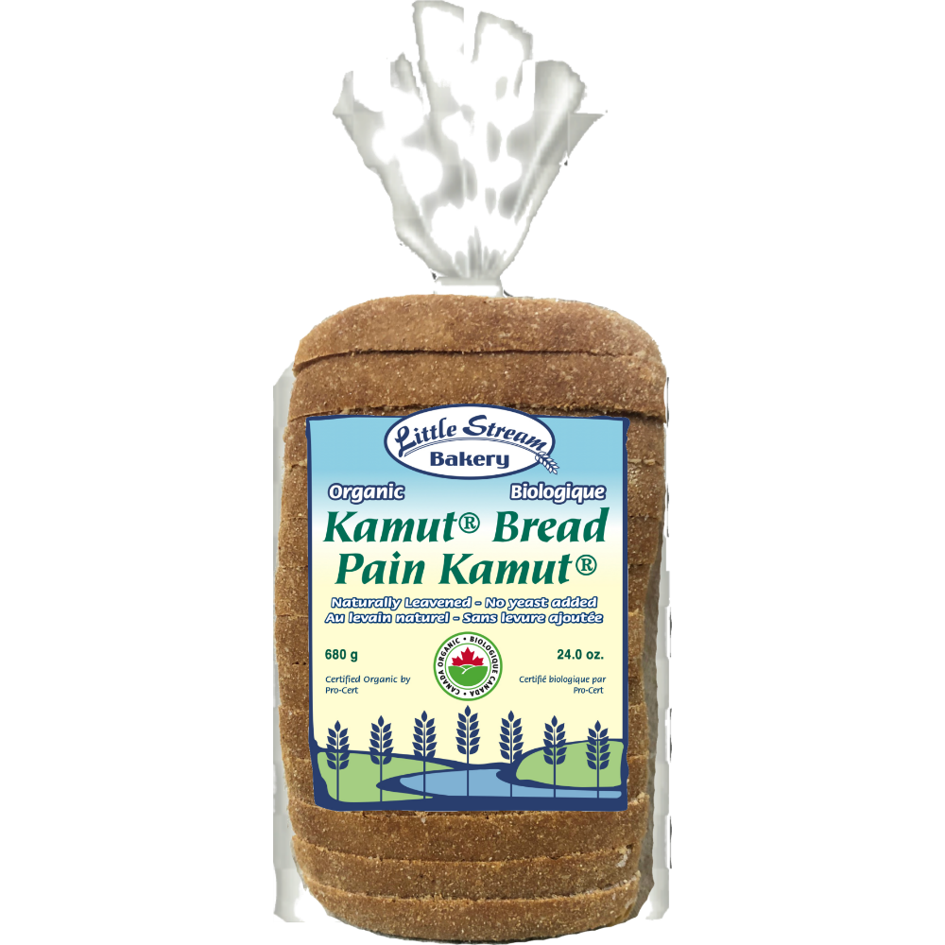
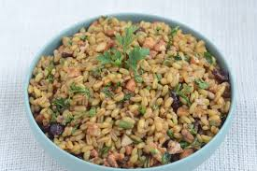
Kamut

Slide 21
Spelt
It is an ancient version of wheat
Easier to digest for many people with a wheat intolerance
Can be used in place of wheat in most recipes
1 cup = 19 grams fiber and 25 grams protein

Slide 22
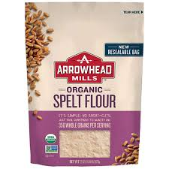
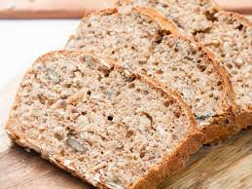
Spelt

Slide 23
Farro
Similar to spelt
Dates back to Roman times
Enjoyed in much of Italian cooking
Hearty and nutty grain that can replace rice or small pasta in dishes like risotto, minestrone and soups
1 cup = 7 grams fiber and 8 grams protein

Slide 24
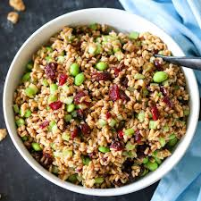
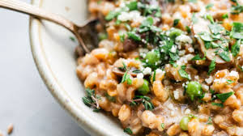
Farro

Slide 25
Bulgar Wheat
Bulgar wheat is parboiled so does not require cooking
It has a light nutty flavor and comes in fine, medium, and coarse grinds
Used in West Asian and Mediterranean cuisines (for tabbouleh, kibbeh, etc) often instead of rice or pasta
1 cup = 8.2 grams fiber and 5.6 grams protein

Slide 26
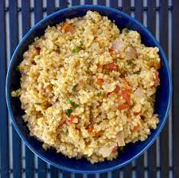
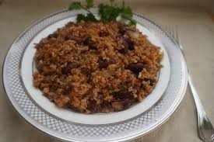
Bulgar wheat

Slide 27
Millet
A yellow grain that likely originated in Ethopia
Naturally glute-free
High in antioxidants
Millet was a daily staple in many areas of Asia before rice became the grain of choice
Can be used in pilafs, breakfast cereals and breads
1 cup millet = 4.2 grams fiber and 13 grams protein

Slide 28
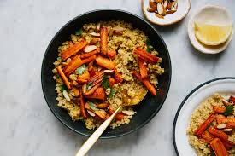
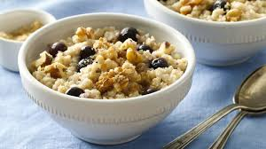
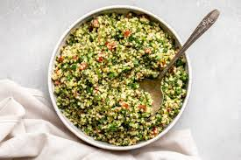
Millet

Slide 29
Rice
Rice is a staple food in over half the world’s population
The nutritional value of rice depends on the strain of rice (white, brown, red, and black varieties) and the nutrient quality of the soil it is grown in
In some countries, we can get parboiled rice. The process steams the grain while it is still a brown rice grain, resulting in nutrients from the outer husk to move into the endosperm. In doing so it increases the nutritional value compared to milled rice, with fewer calories, fewer carbs, more fiber and more protein.
1 cup of white rice = 0.6 grams fiber and 4.3 grams protein
1 cup of brown rice = 3.23 grams fiber and 5.54 grams protein

Slide 30
Corn
Corn (maize) is a cereal grain first domesticated by indigenous peoples in southern Mexico about 10,000 years ago.
Corn is rich in fiber but very high in starch, causing spikes in blood sugar for some individuals.
Avoidance of processed corn products such as corn syrups and corn starches is recommended
1 cup of corn=3.28 grams of fiber and 4.3 grams protein

Slide 31
Oatmeal
Oatmeal is a preparation of oats that been de-husked, steamed and flattened.
Steal cut oats are a coarse oatmeal
Rolled oats are thick old-fashioned oats and may be quick oatmeal or instant oatmeal based on the cooking time required.
Oatmeal can be prepared in different ways to create porridge, gruel, etc.
1 cup oatmeal= 4 grams fiber and 6 grams protein

Slide 32
Ancient Grains Comparison
Name | Fiber | Protein | Uses | Gluten-Free
Quinoa | 5.18 grams | 8.14 grams | savory dishes/breakfast | yes
Barley | 6 grams | 3.6 grams | soups/stews/cereals | yes
Buckwheat | 4.5 grams | 5.7 grams | pancakes/soups/stews/cereal | yes
Amaranth | 6 grams | 9 grams | cereals/breads/pancakes | yes
Kamut | 7.4 grams | 9.8 grams | baked goods/breads/cookies | no
Spelt | 19 grams | 25 grams | baked goods/breads/cookies | no (better for wheat intolerance)
Farro | 7 grams | 8 grams | like rice/risotto/in soups | no (better for wheat intolerance)
Bulgar wheat | 8.2 grams | 5.6 grams | like rice or pasta/tabbouleh | no
Millet | 4.2 grams | 13 grams | pilafs/cereals/breads | yes
White rice | 0.6 grams | 4.3 grams |  | yes
Brown rice | 3.23 grams | 5.54 grams |  | yes
Corn | 3.28 grams | 4.3 grams | vegetable/cereal/polenta | yes
Oatmeal | 4 grams | 6 grams |  | yes

